Slide 1
E-commerce web-app management
ABOUT
BUDGET
PROJECT
TIMELINE
A PROJECT DATABASE
PROJECT PROPOSAL

Slide 2




OUR TEAM
TRAN ANH 20215179
DO HONG HAI 20215199
DOAN ANH KHOA
ABOUT
BUDGET
PROJECT
TIMELINE
MAI DUC AN
20210008
SILDES & SUPPORT FRONT AND BACK END
FRONT-END
BACK-END
QUERY DATABASE
PROJECT PROPOSAL

Slide 3
FUNCTIONS OF THE WEB-APP
ABOUT
BUDGET
PROJECT
TIMELINE
This is an admin web-app of an e-commerce web page, used by the seller to manage customers, inventory(products), imports & orders and providers information by some functions such as: add, edit, delete, update, …
PROJECT PROPOSAL

Slide 4
RELATIONAL TABLES

Slide 5
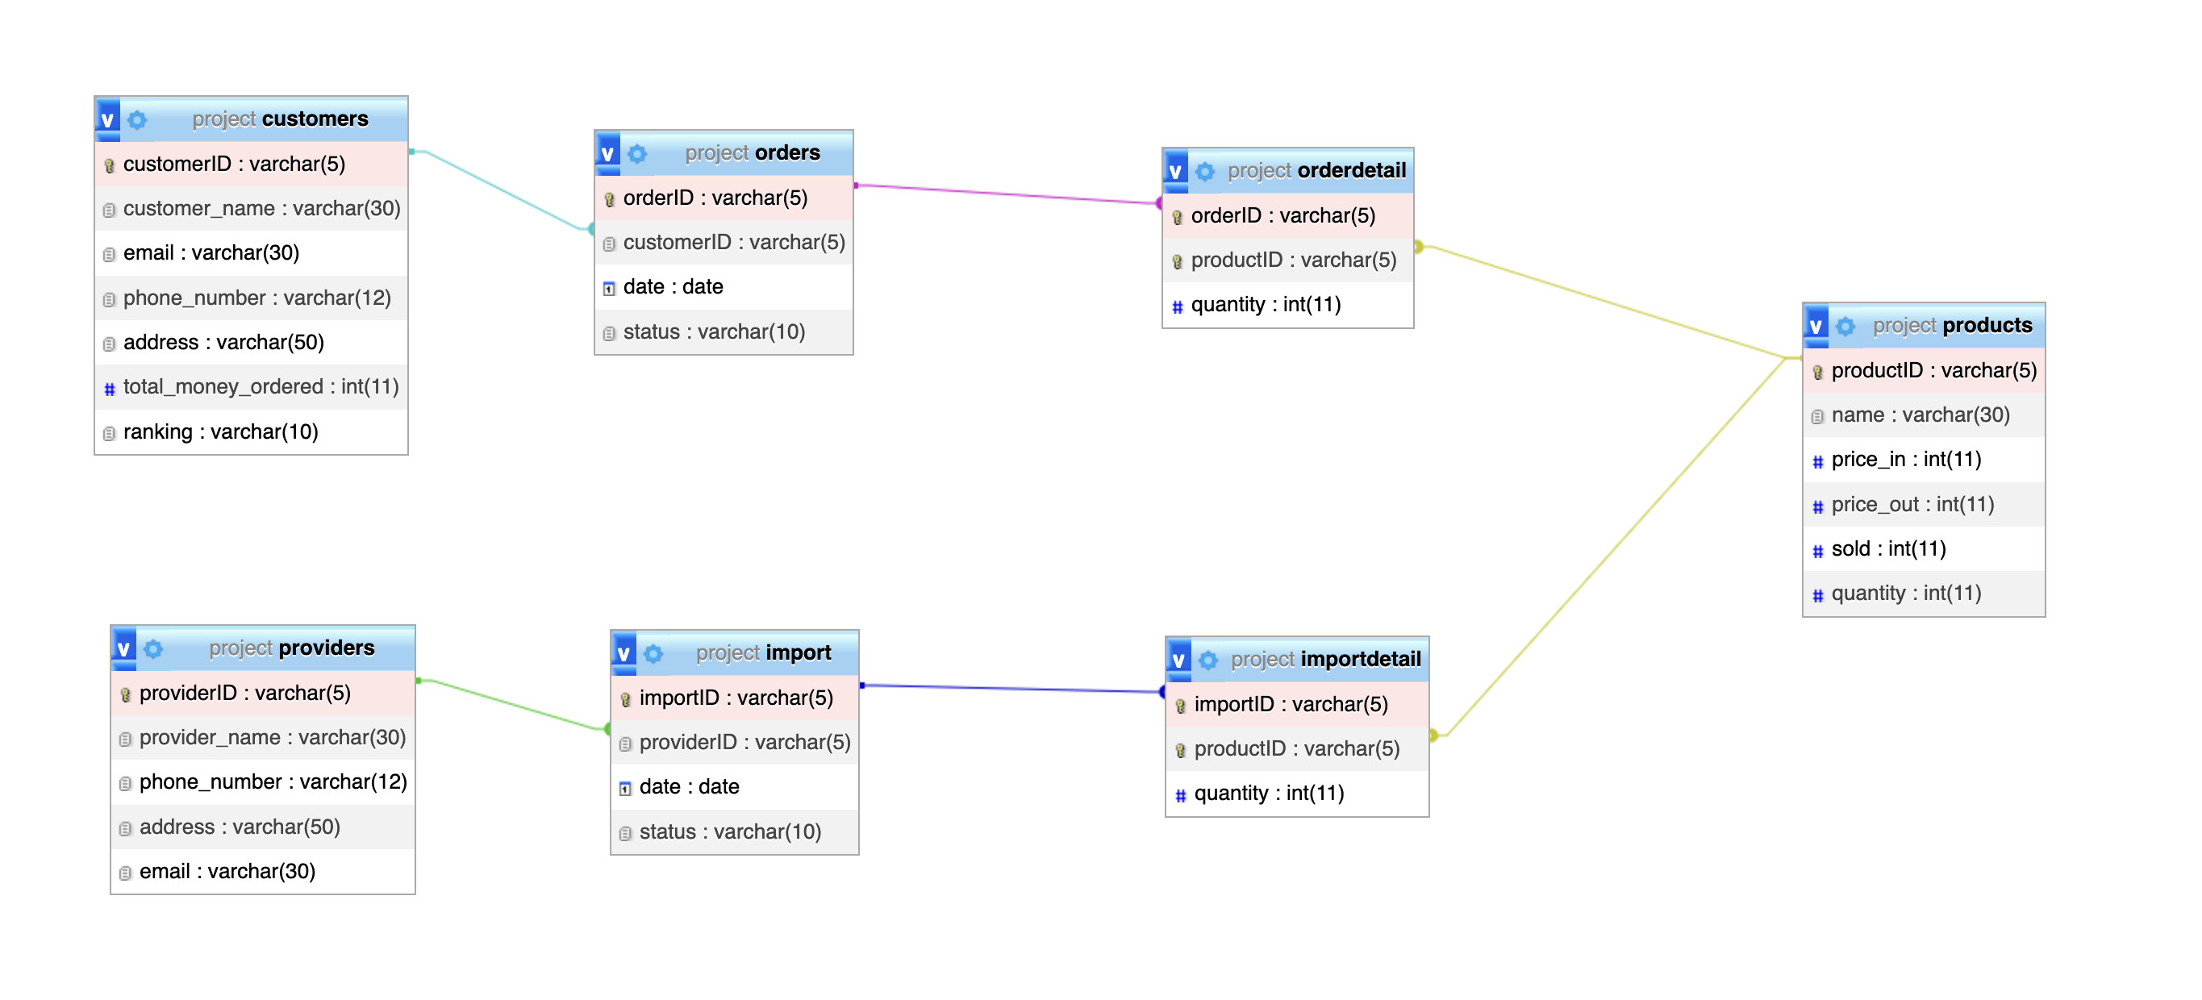
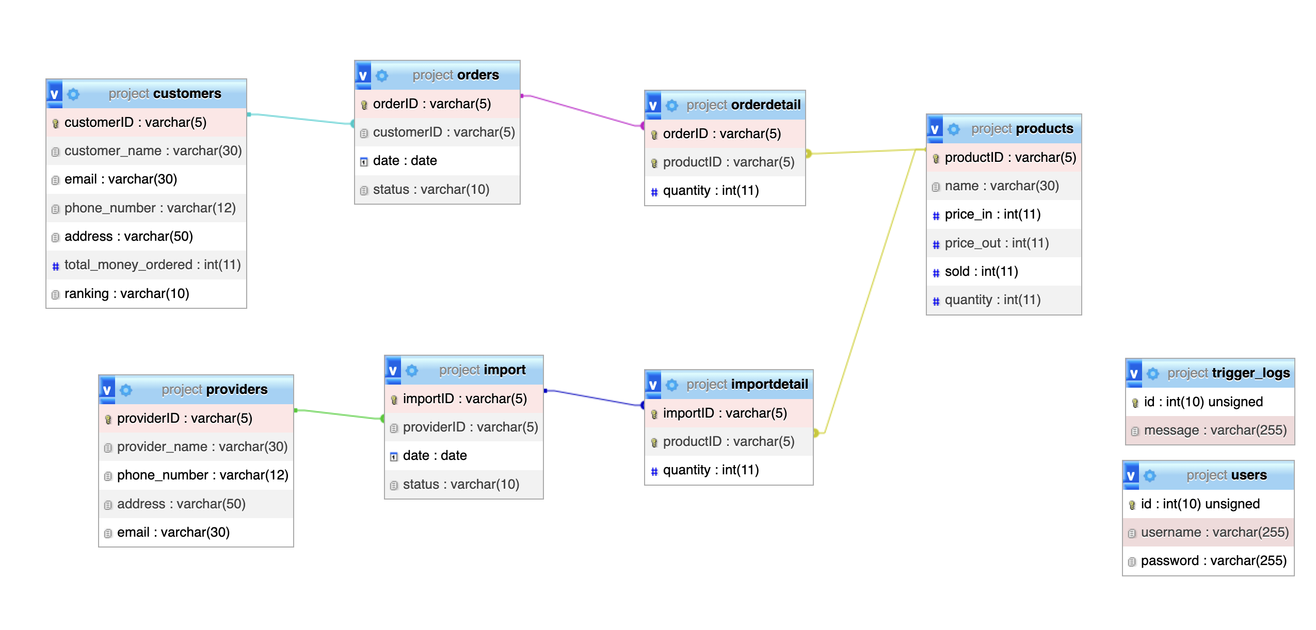

Slide 6
Login system

Slide 7
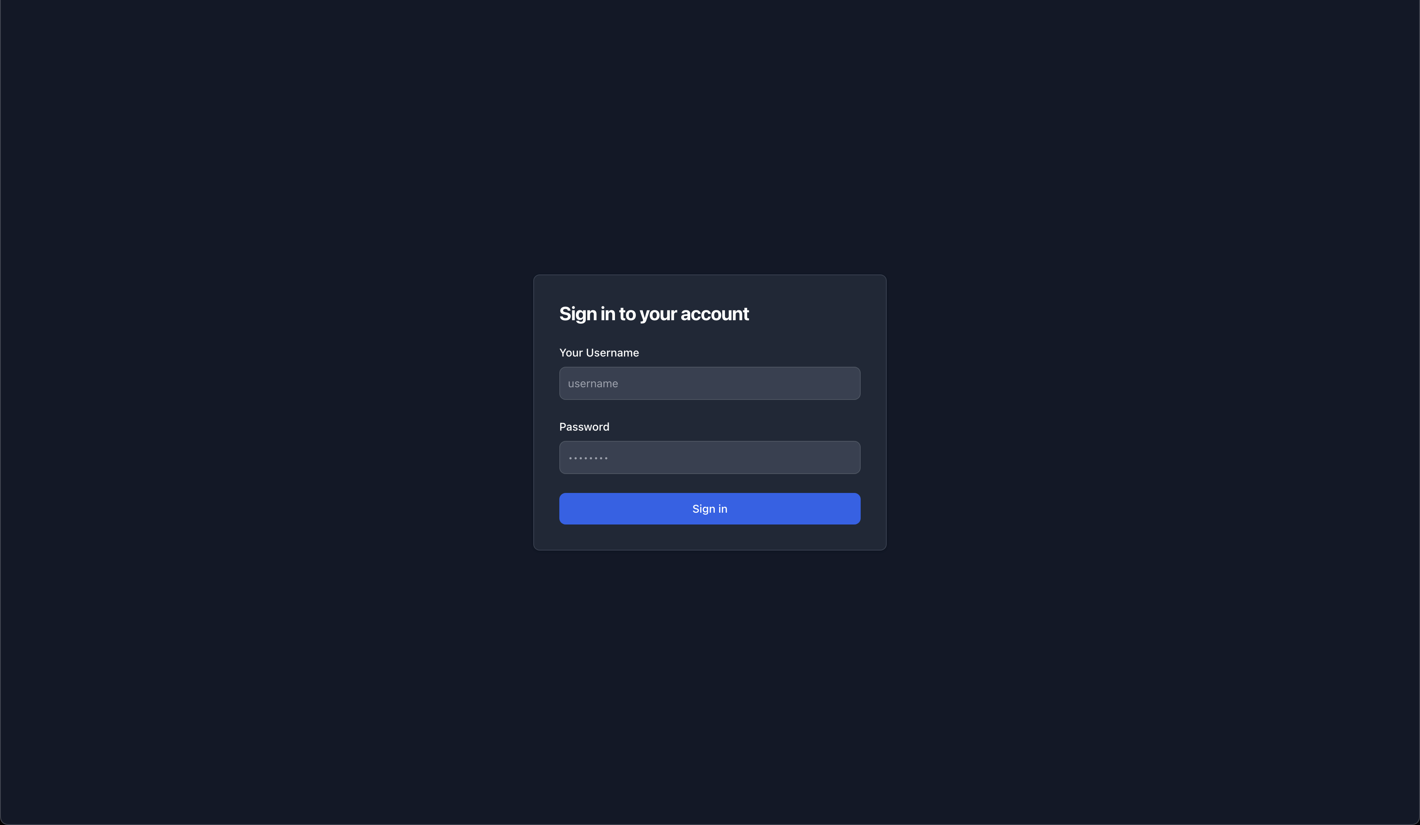

Slide 8
WEB-APP OVERVIEW

Slide 9
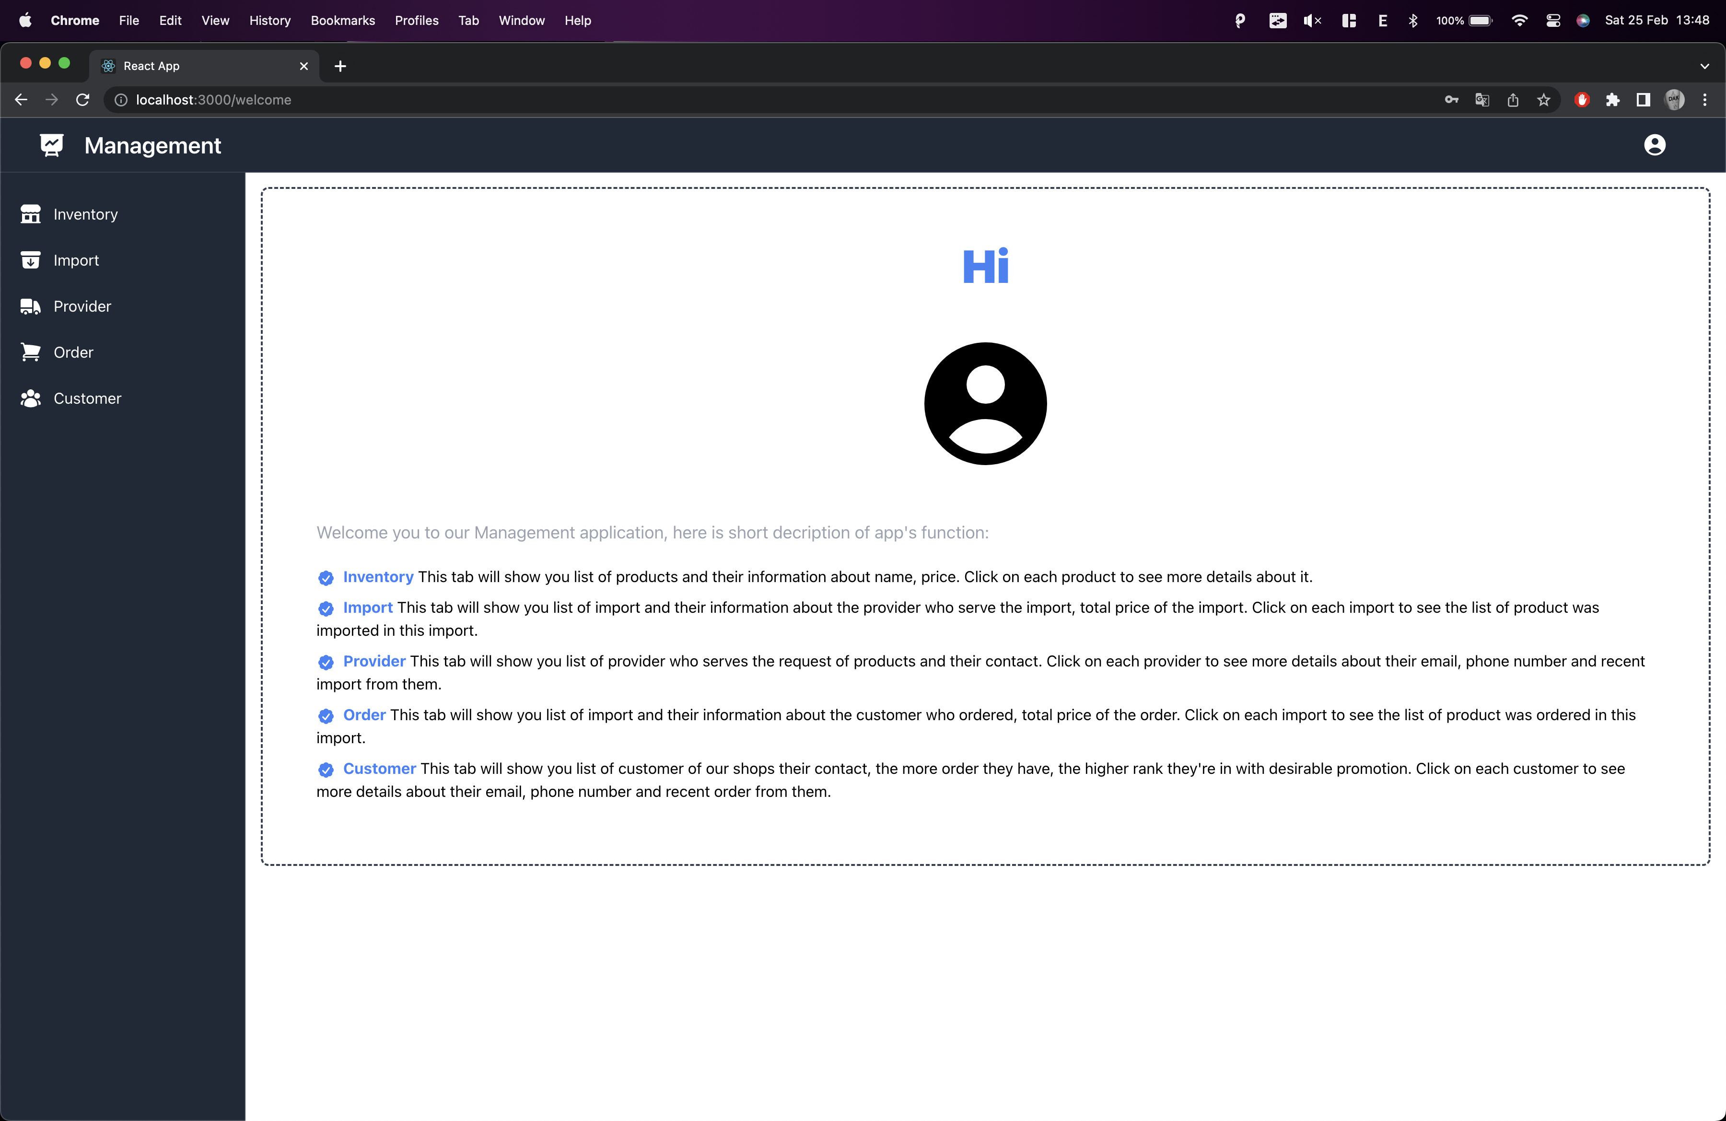

Slide 10
FUNCTIONS OF THE APP
01
02
03
04
Cutomers management
Inventory management
Import & order management
Providers management

Slide 11
01
CUSTOMERS MANAGEMENT

Slide 12
We can add a new customer, delete and update info of an existed customer and show the customers’ info, find a customer by name.

Slide 13
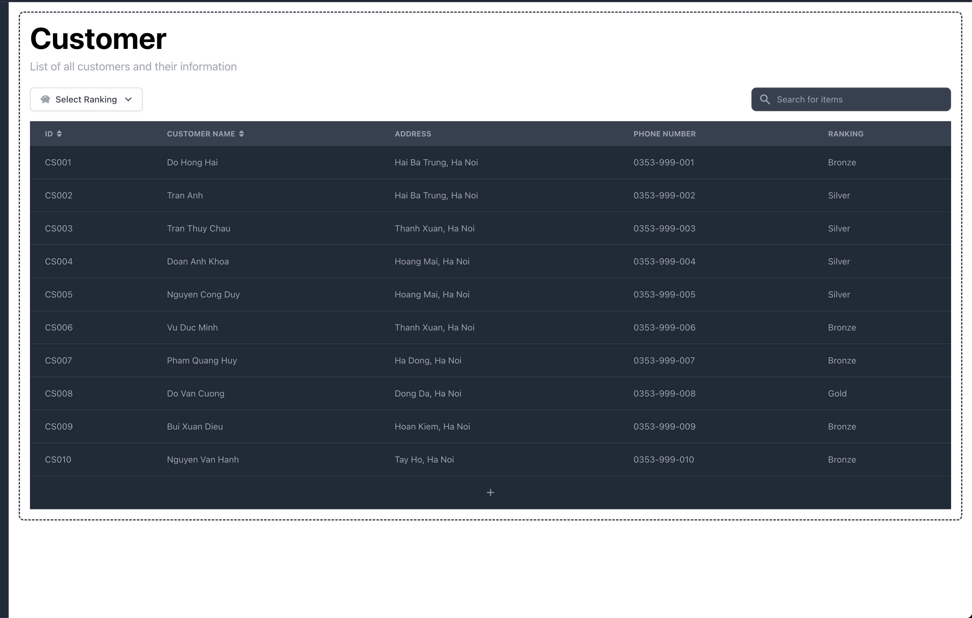
Show customers ‘info, search by name, show by ranking(from high to low)

Slide 14
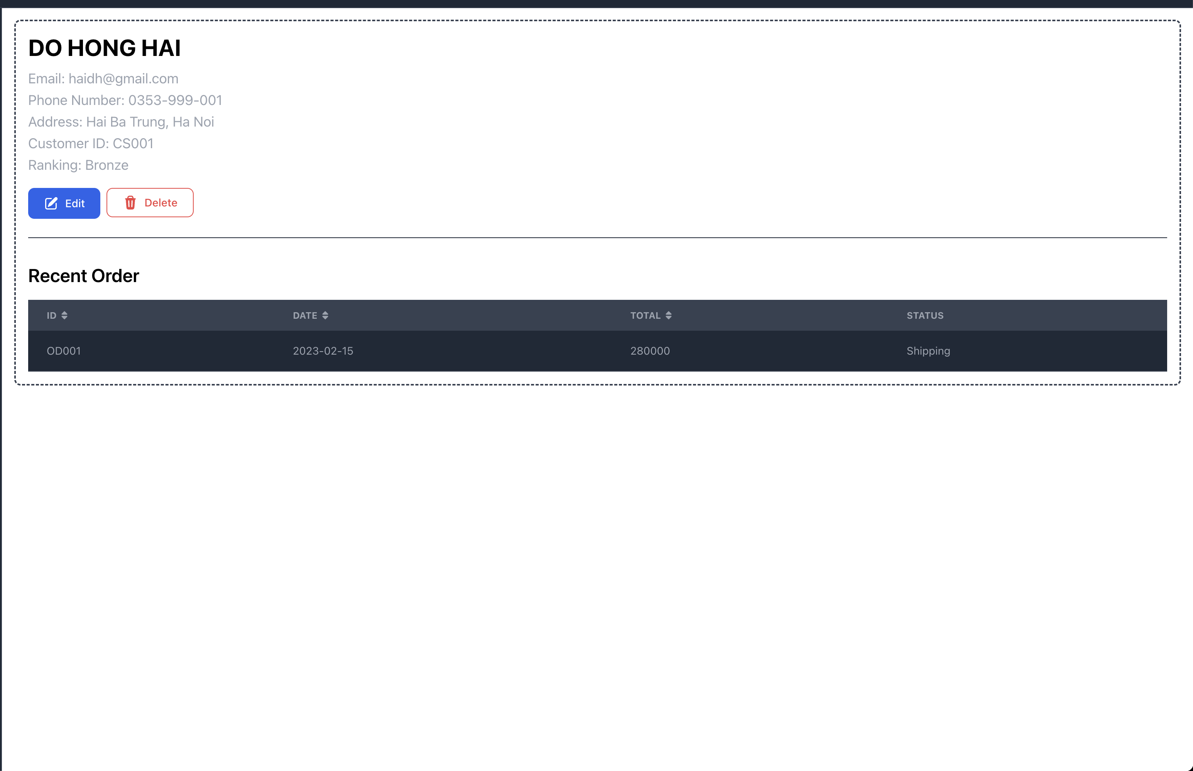
Show customers‘ info, edit & delete, show customer’ orders info

Slide 15
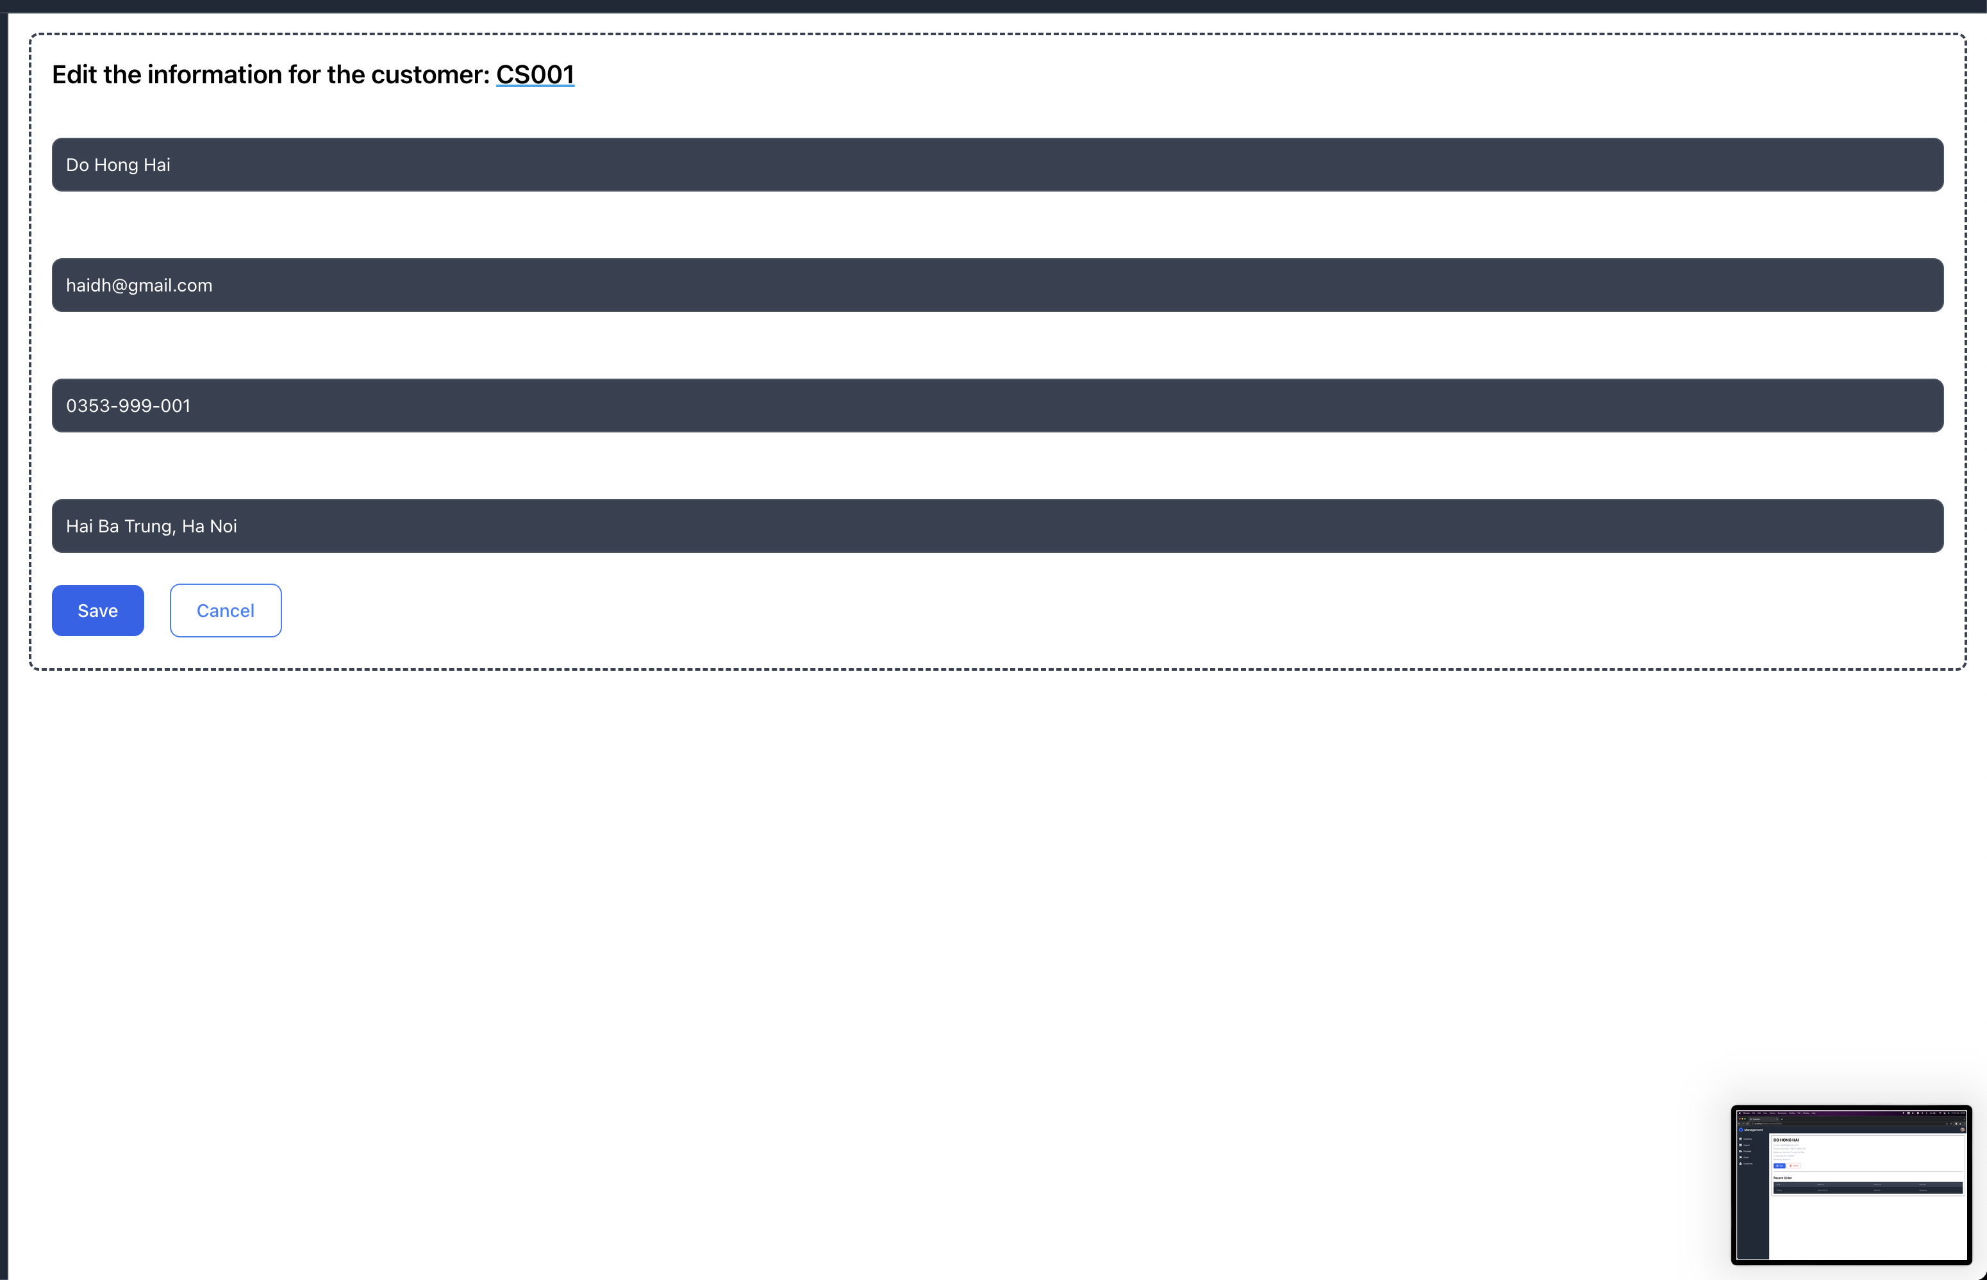
Update customer‘ infor

Slide 16
02
Inventory management

Slide 17
We can add a new product, delete and update info of an existed product and show the products’s info, search a product by it‘s name

Slide 18
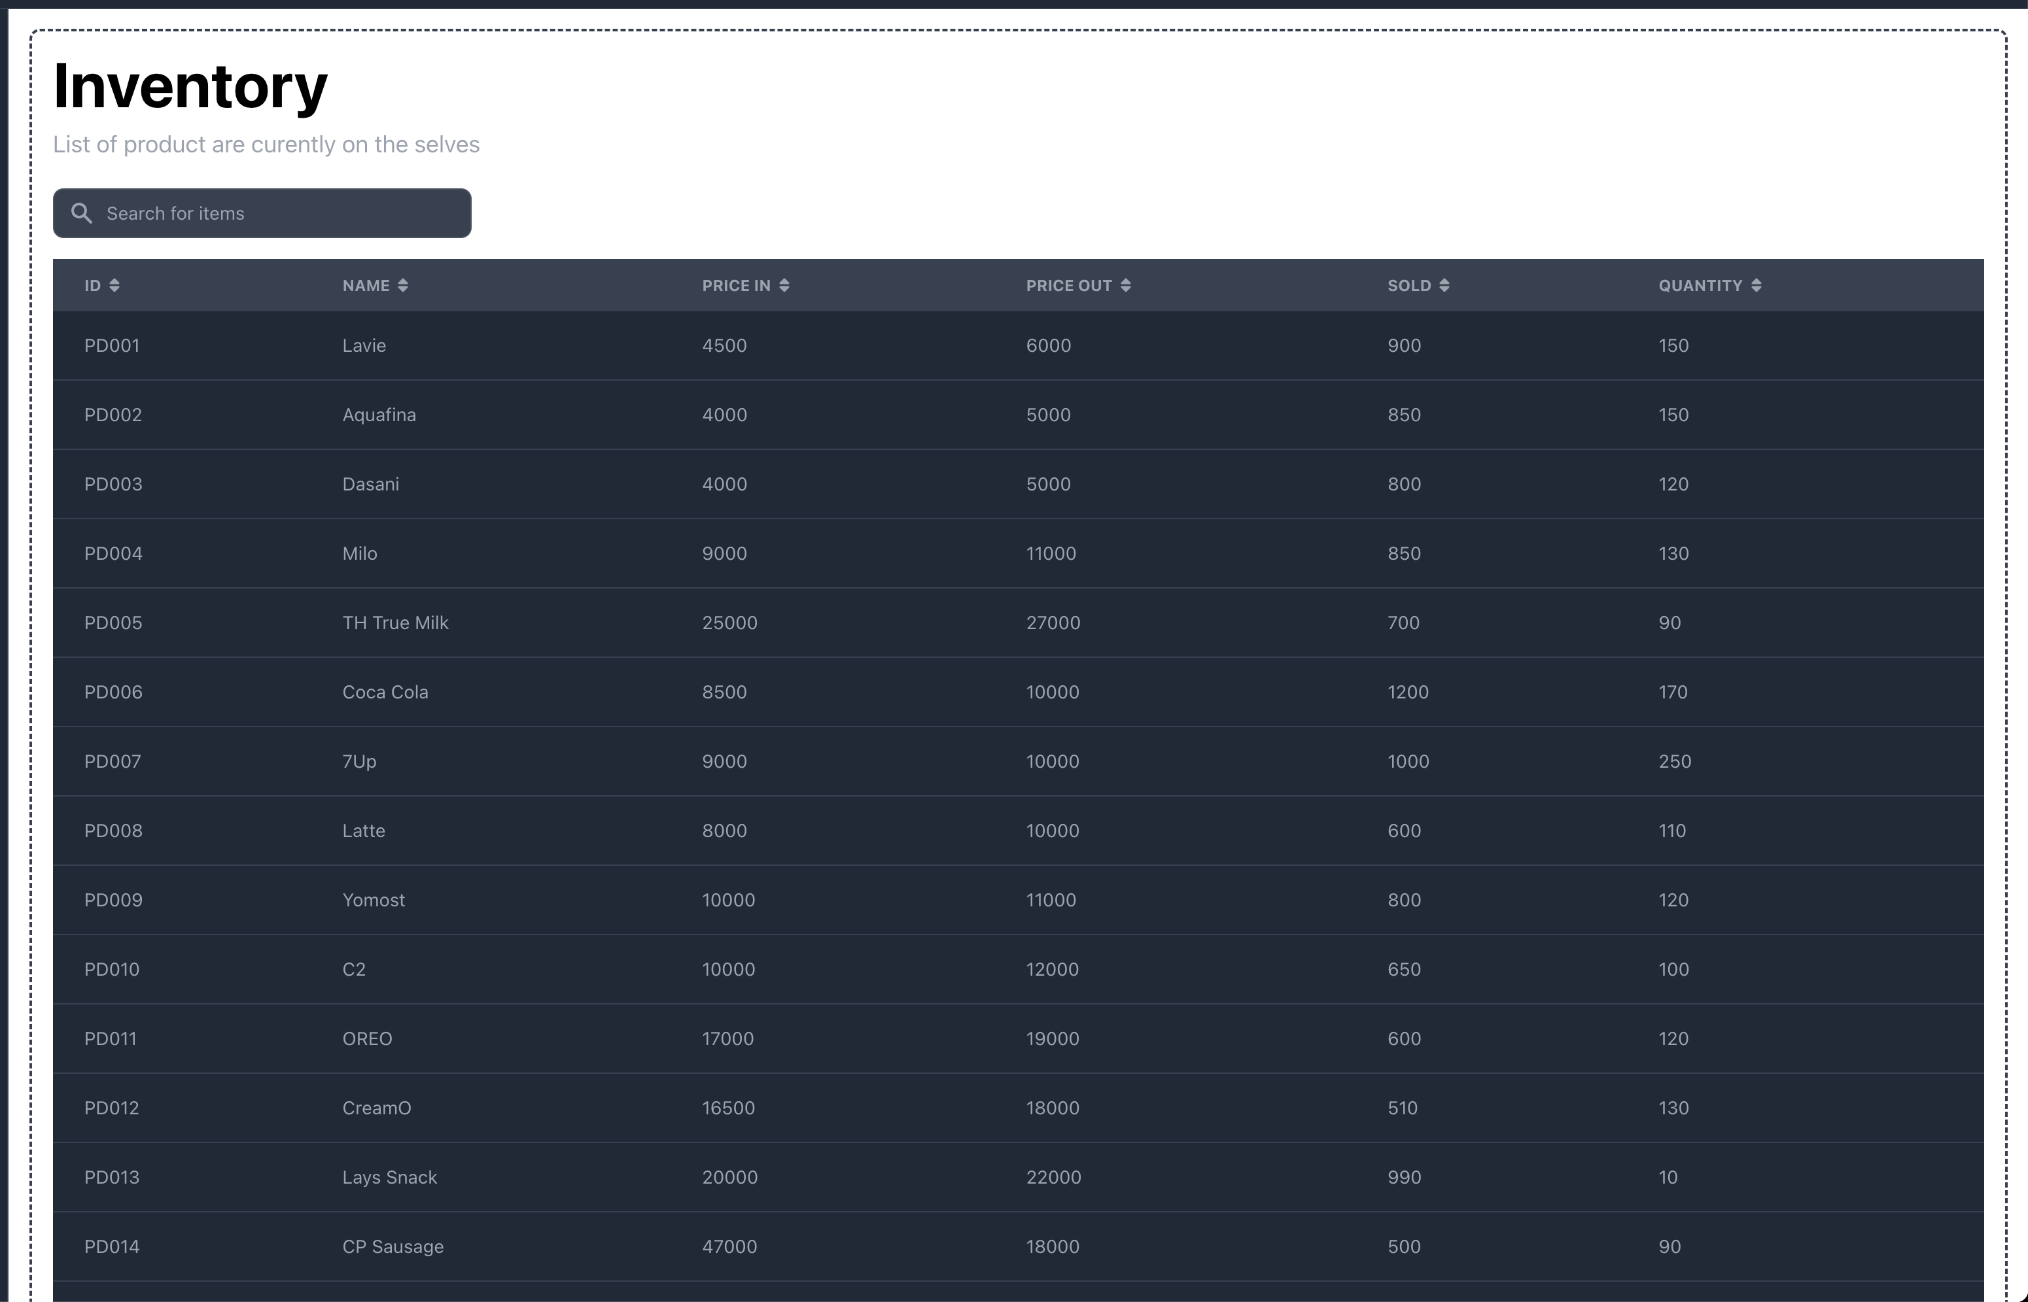
Show products‘ info, search a product by it‘s name

Slide 19
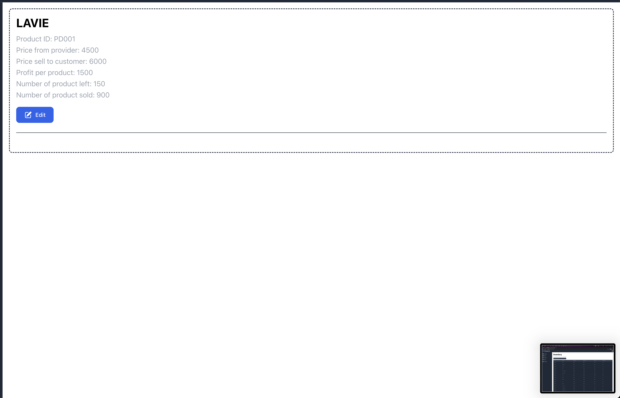
Show a product’ info, choose to the update product‘ info

Slide 20
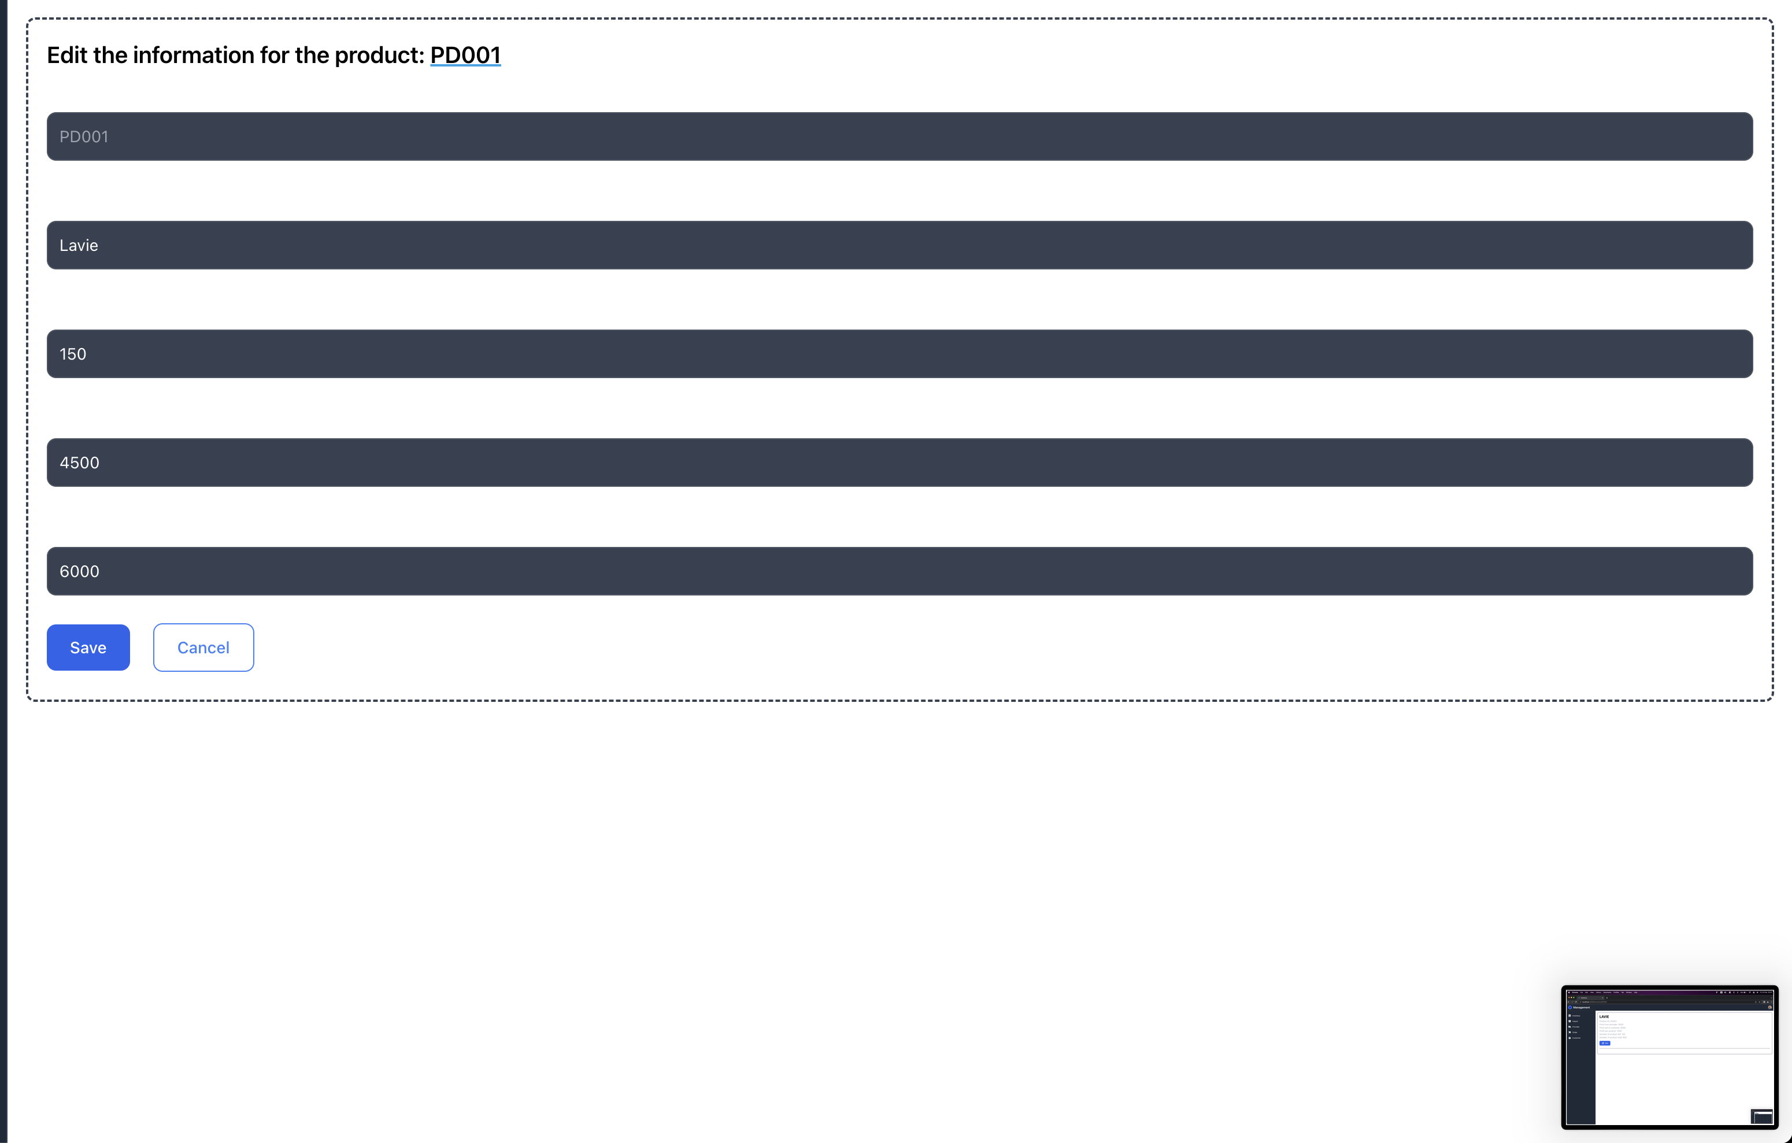
Update a product‘ info

Slide 21
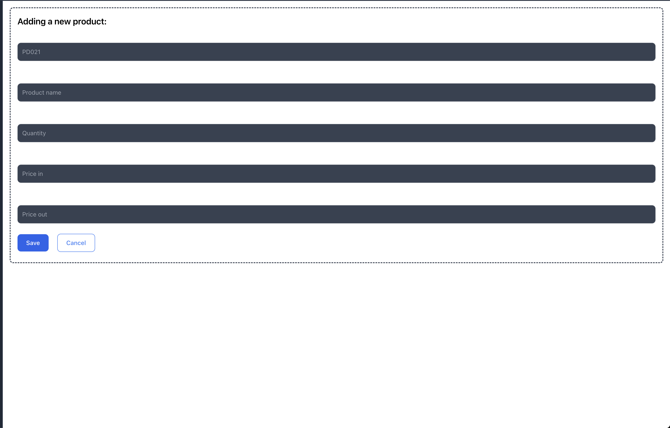
Insert a new product

Slide 22
03.Import & order
ABOUT
BUDGET
PROJECT
TIMELINE
MANAGEMENT
PROJECT PROPOSAL

Slide 23
ABOUT
BUDGET
PROJECT
TIMELINE
“We can show info of new import orders, category them by timestamp. If an import order is checked, the amount of its products in the inventory will be increased or else when is rejected not thing will be changed..”
PROJECT PROPOSAL

Slide 24
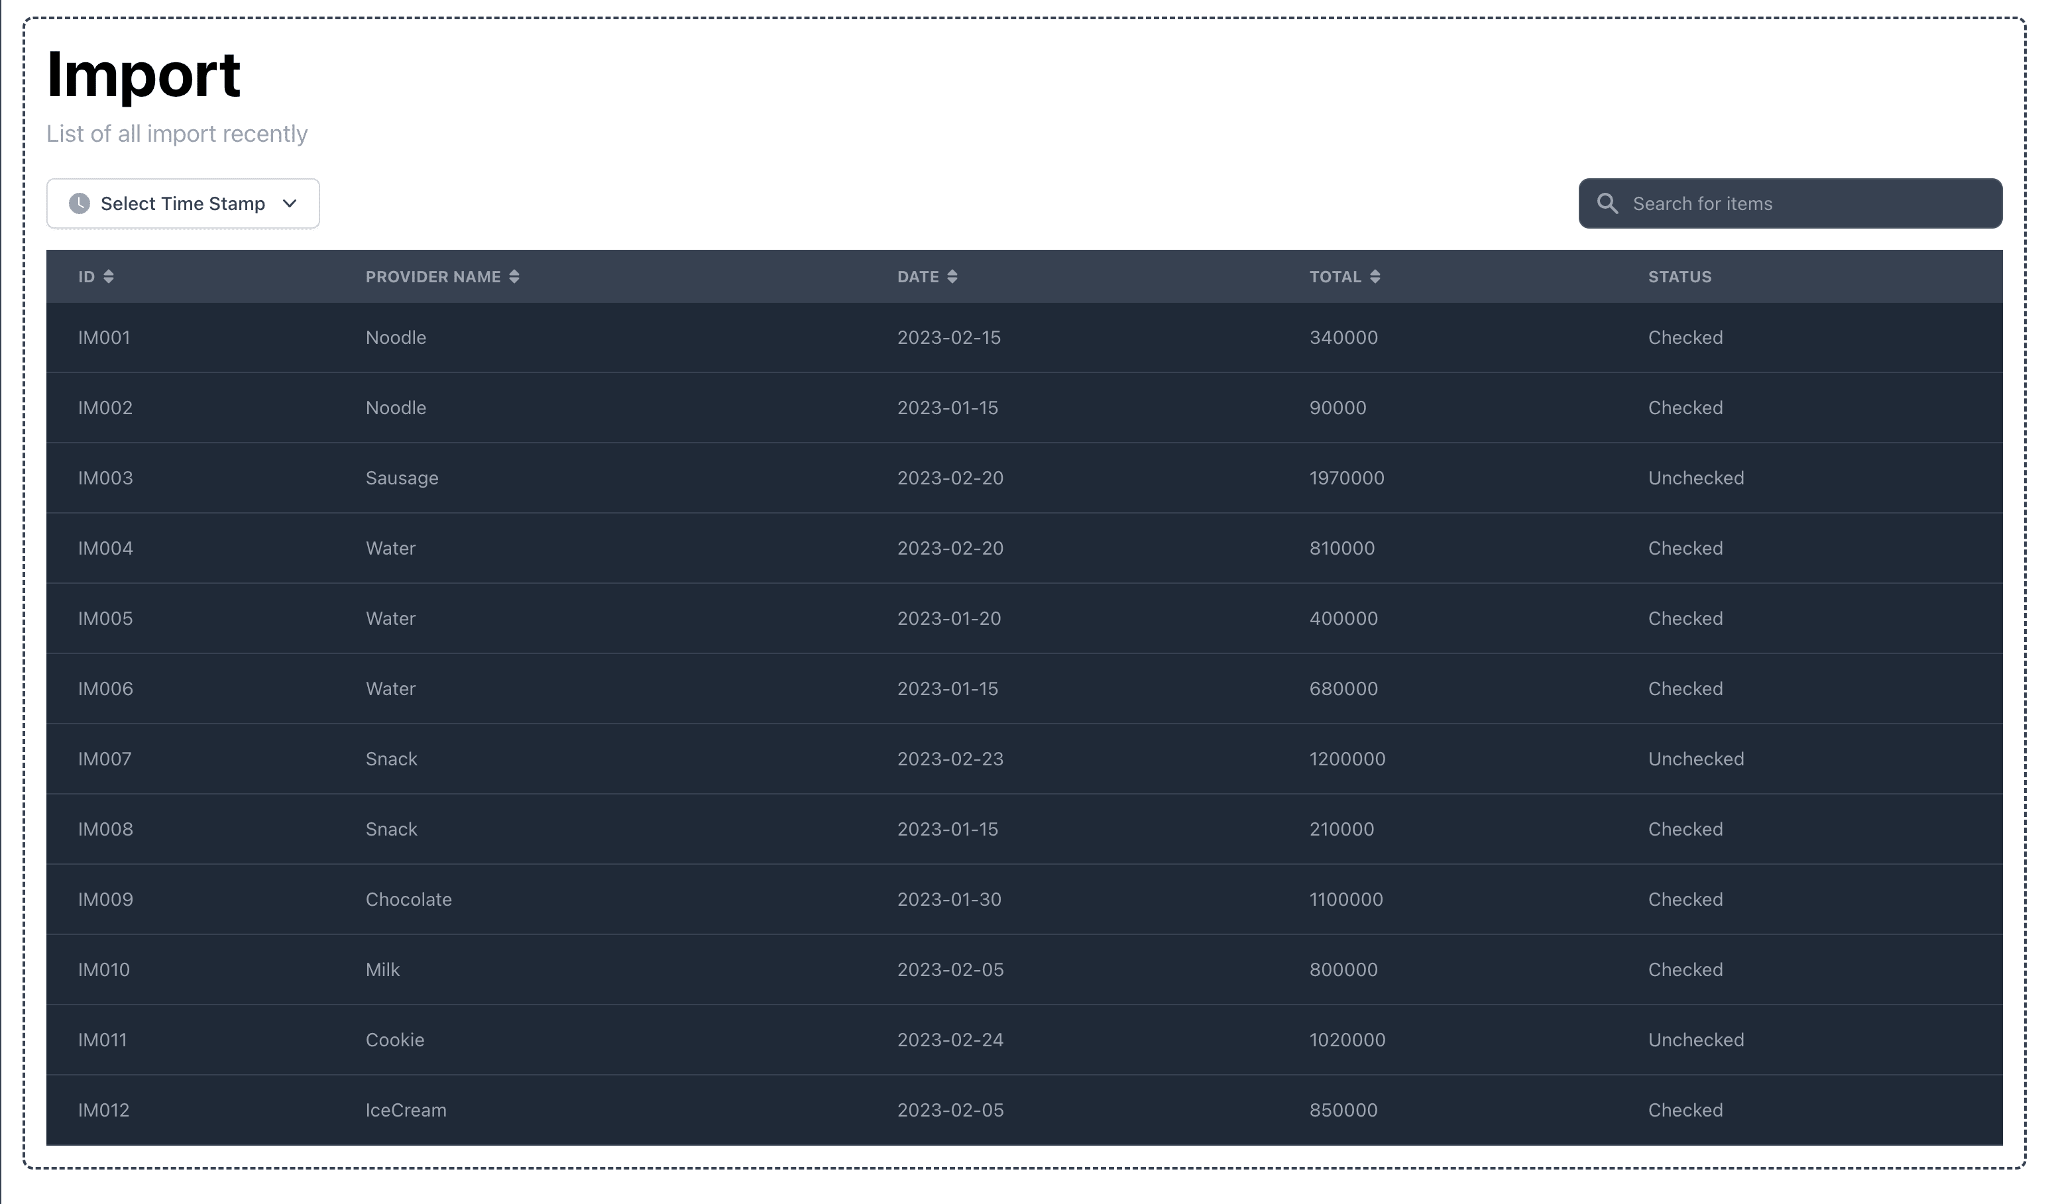
Show import order, search by timestamp, …

Slide 25
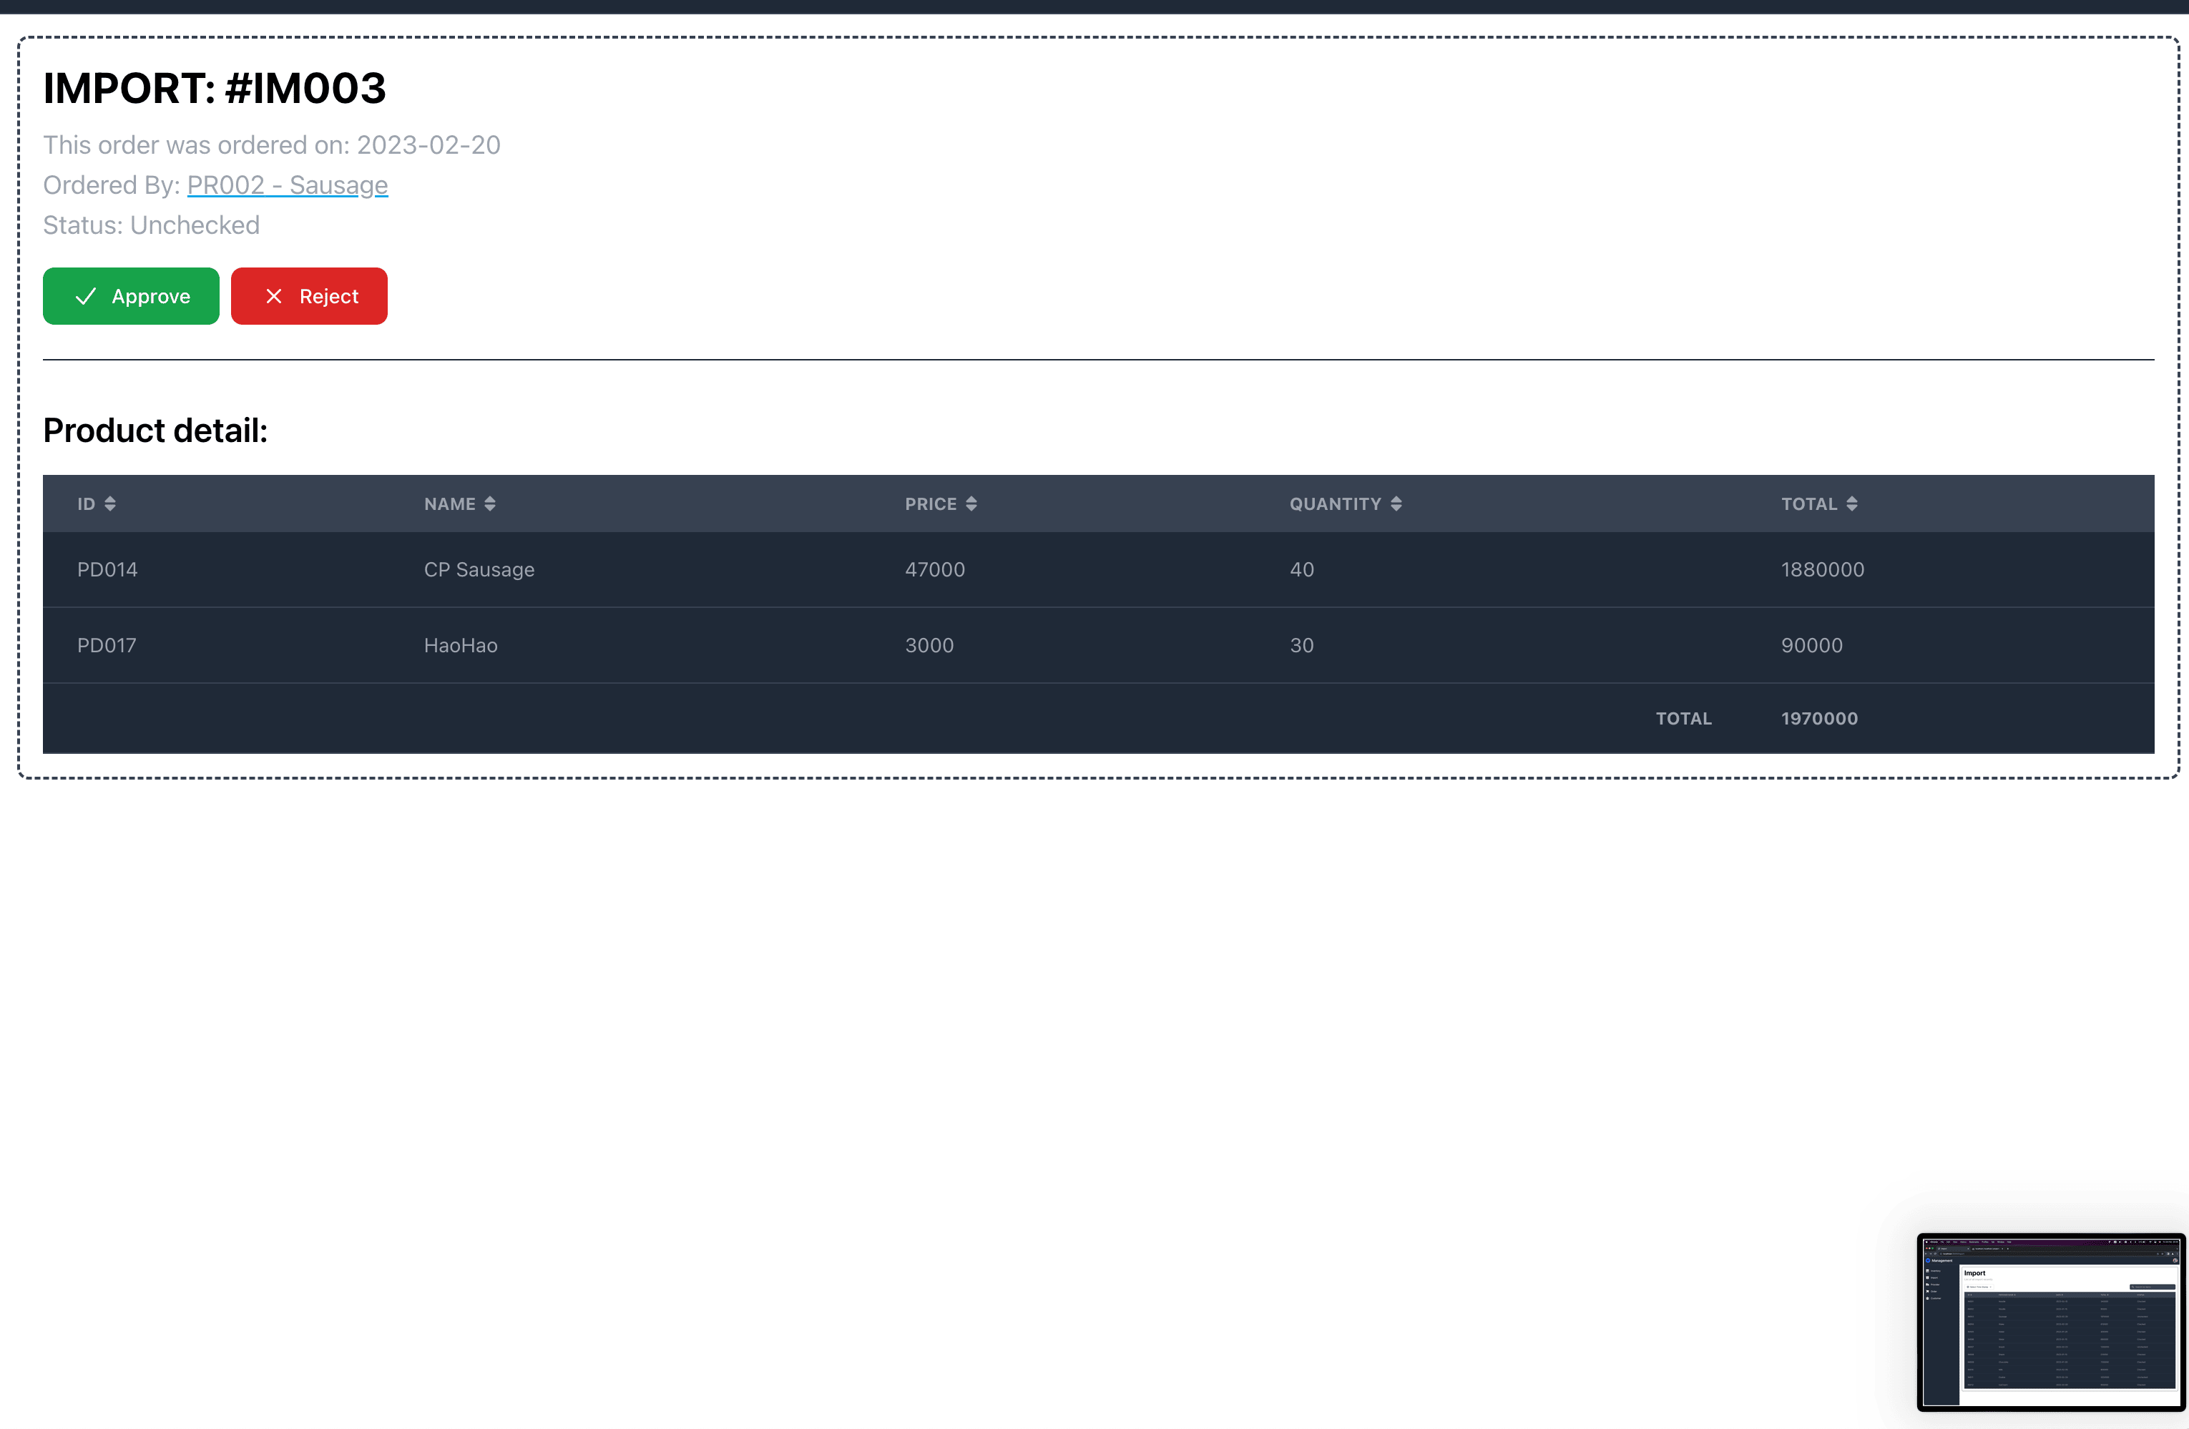
Show an import order detail, it‘s product detail and choose to approve or reject

Slide 26
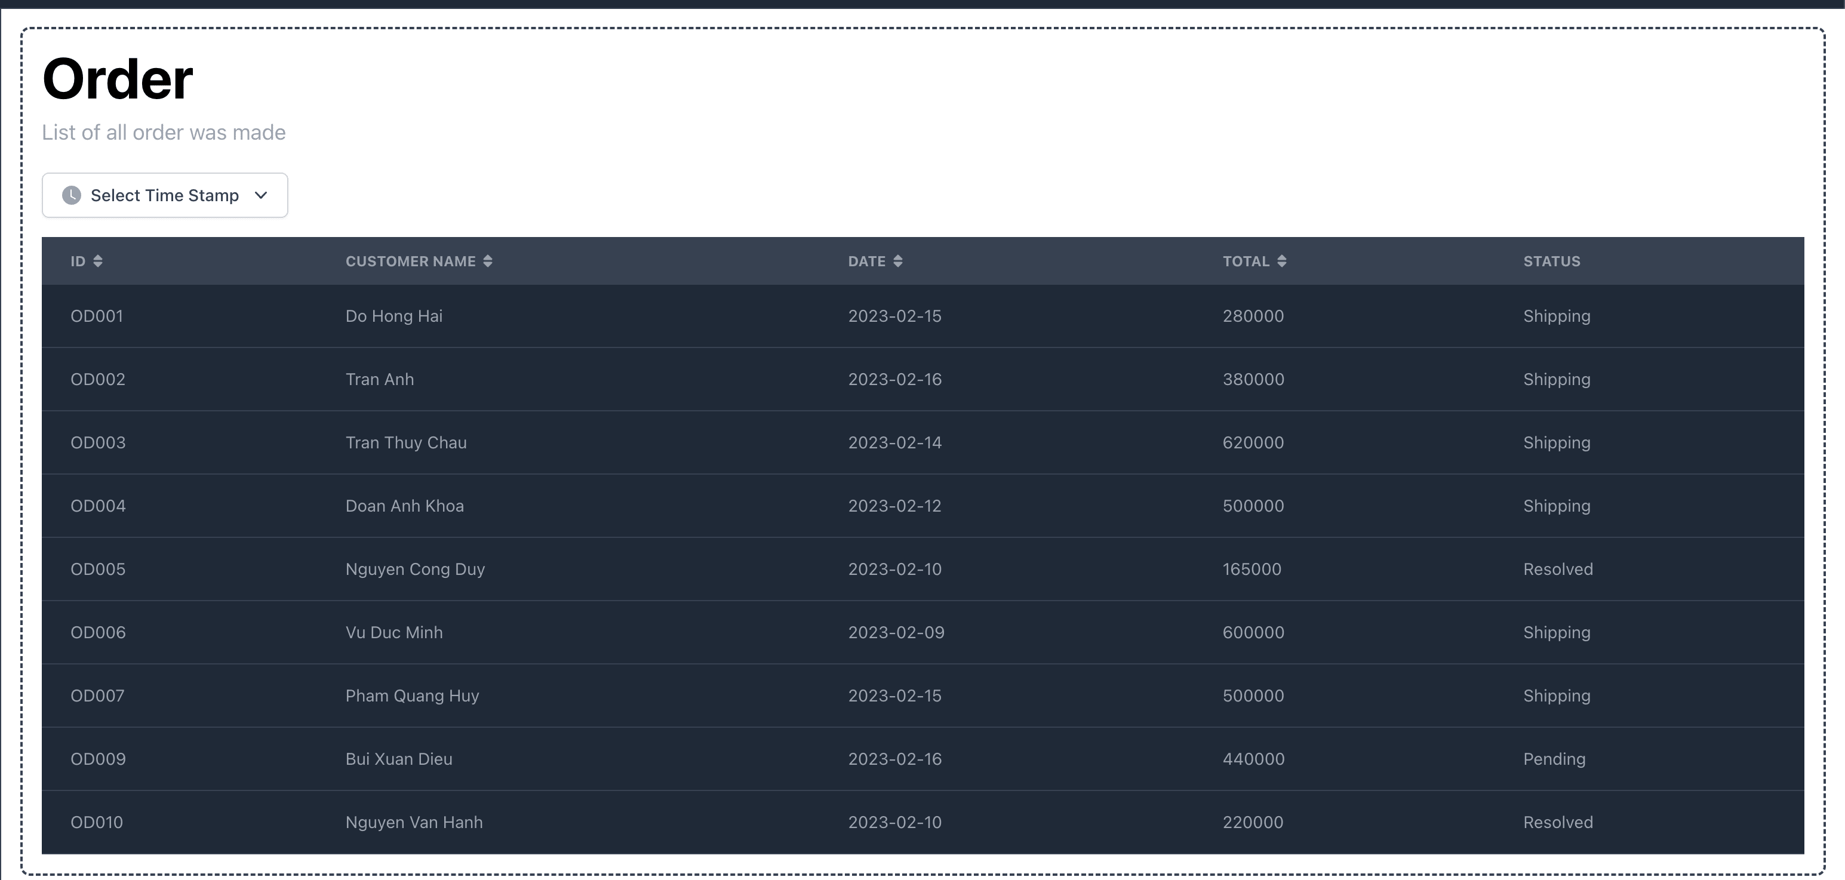
Show all order‘ detail, search by timestamp

Slide 27
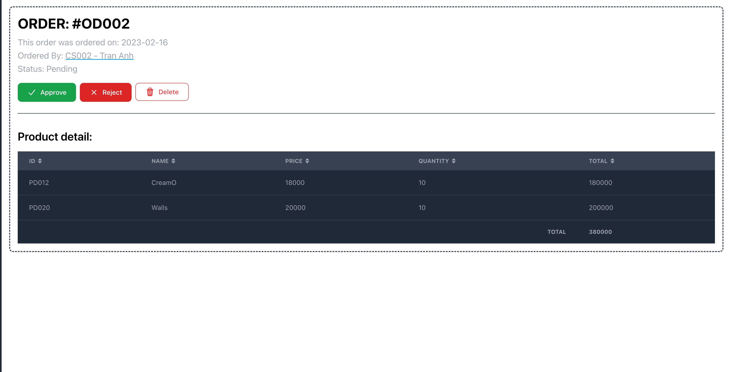
Show order‘ detail, product‘ detail, choose to approve, reject or delete

Slide 28
04
ABOUT
BUDGET
PROJECT
TIMELINE
.Providers
management
PROJECT PROPOSAL

Slide 29
We can show info of all providers, search a provider by name, add, delete, update provider.

Slide 30
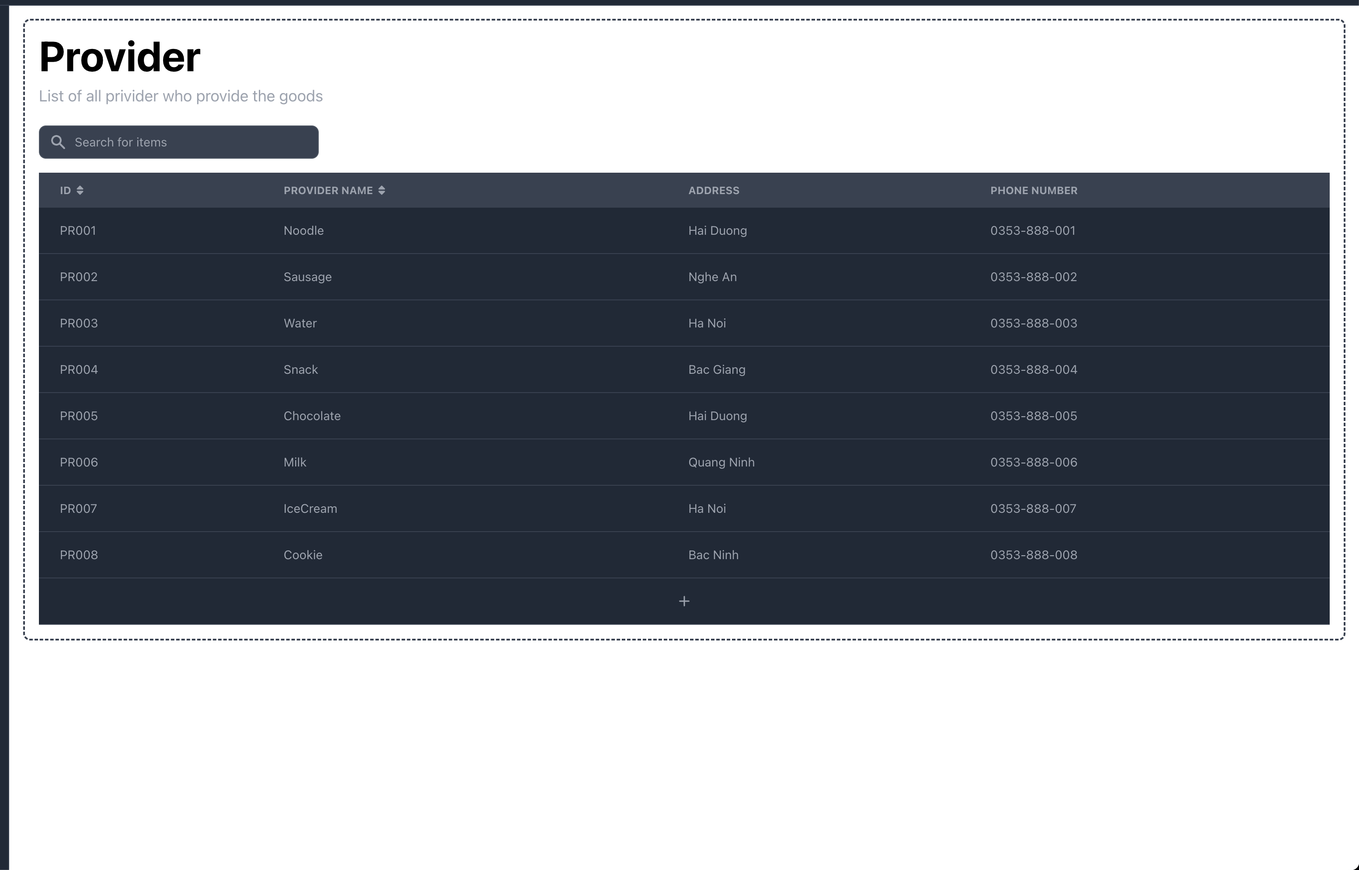
Show all providers, search by name, …

Slide 31
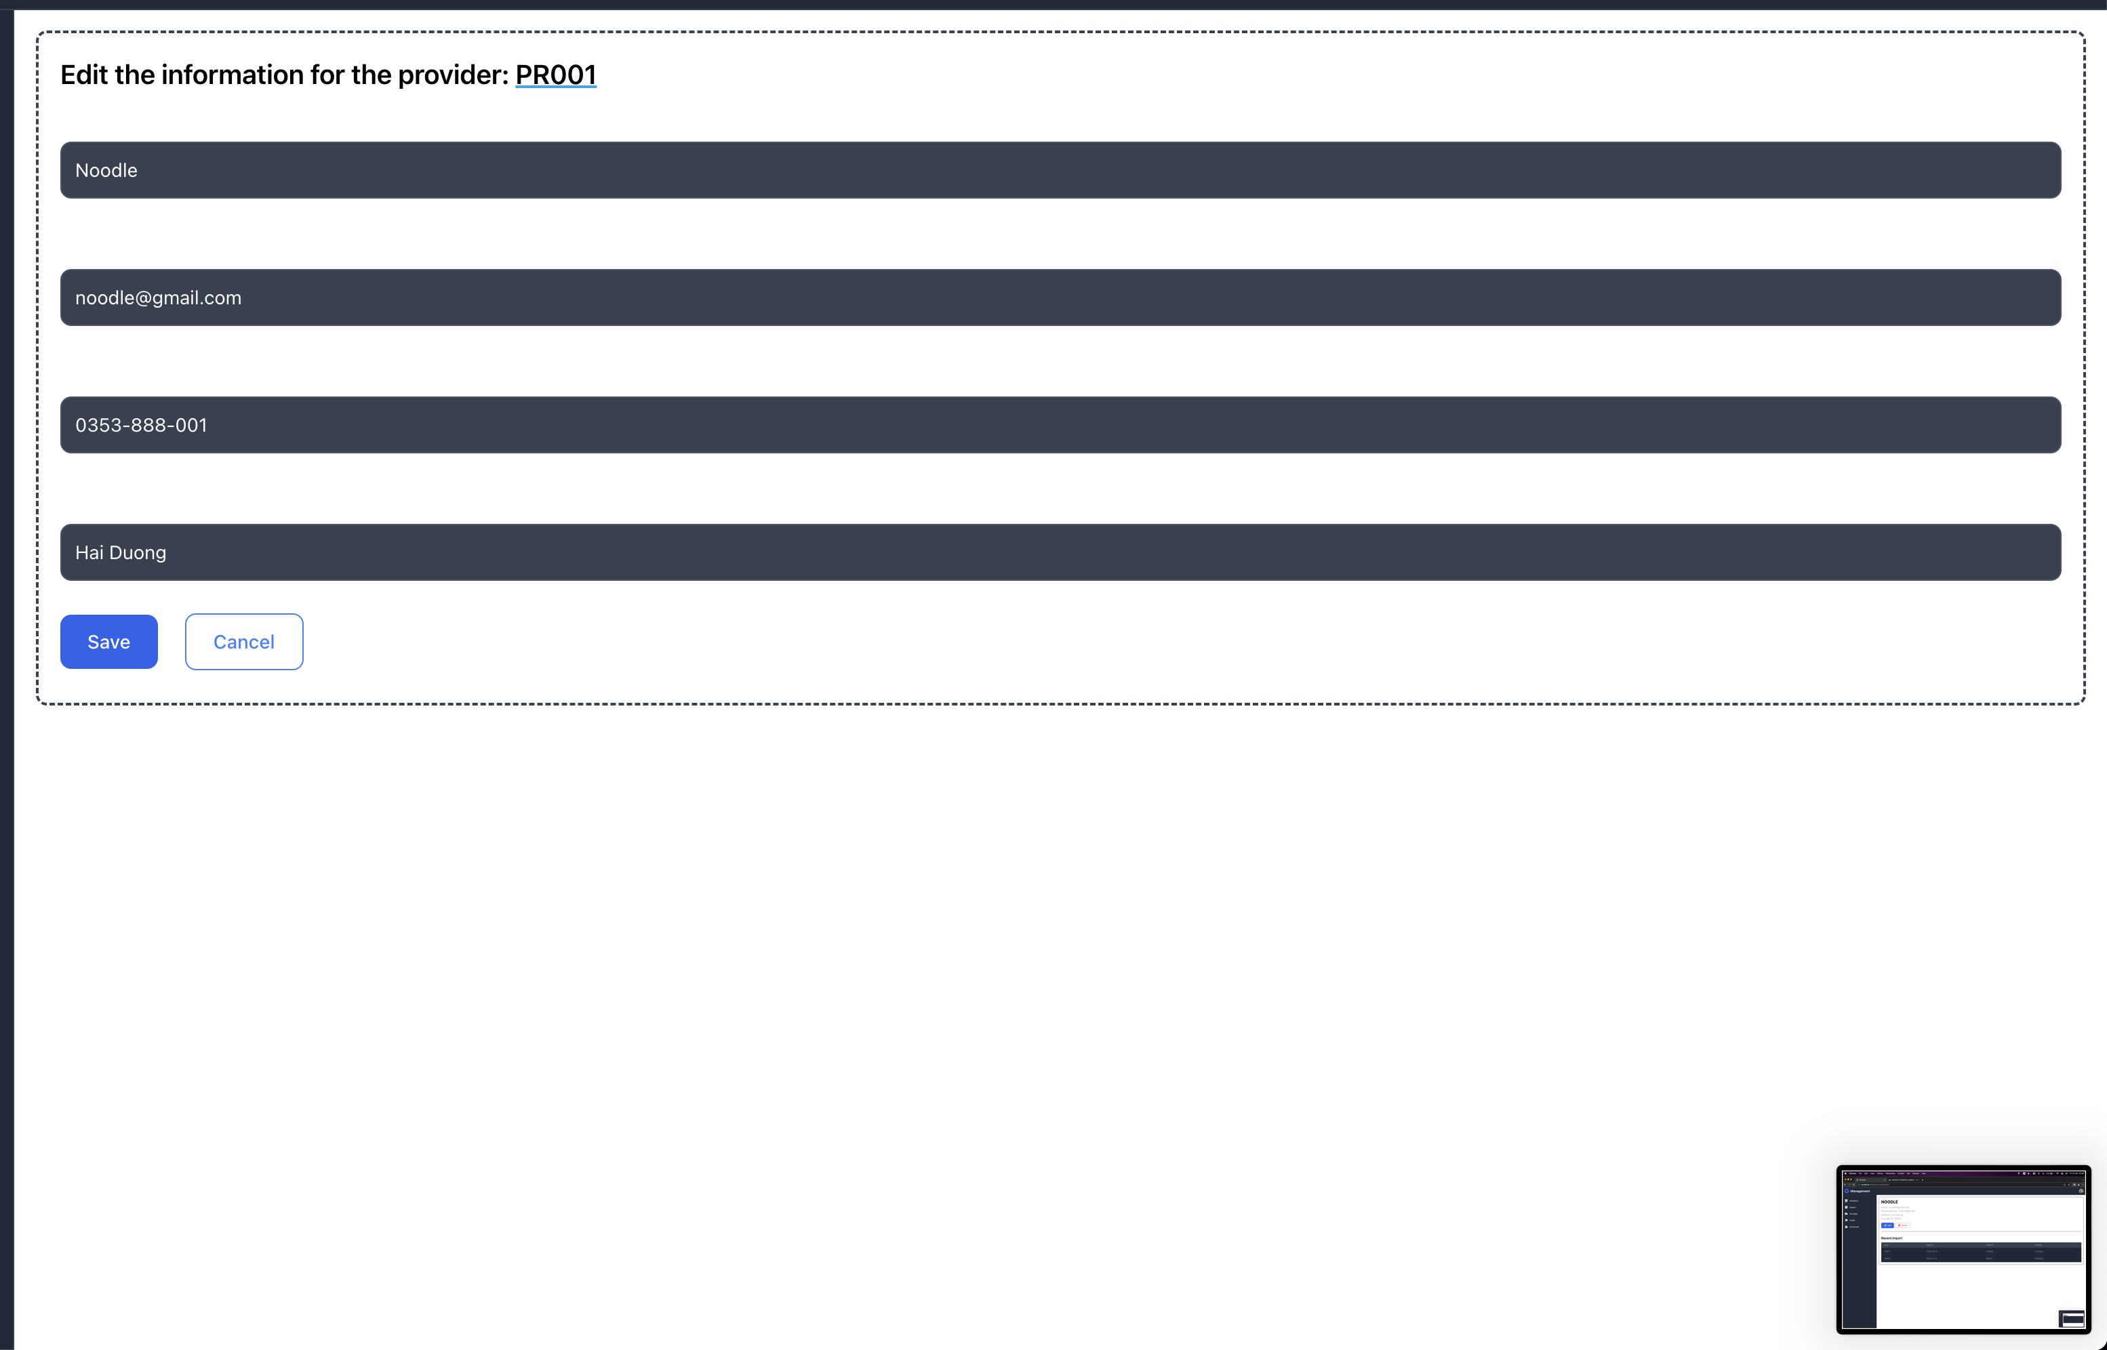
Update information of an existed provider

Slide 32
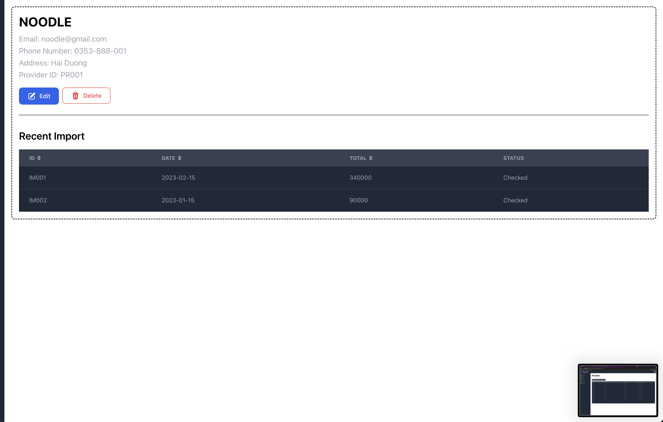
Show info of a provider, his/her recent imports, choose to update or delete

Slide 33
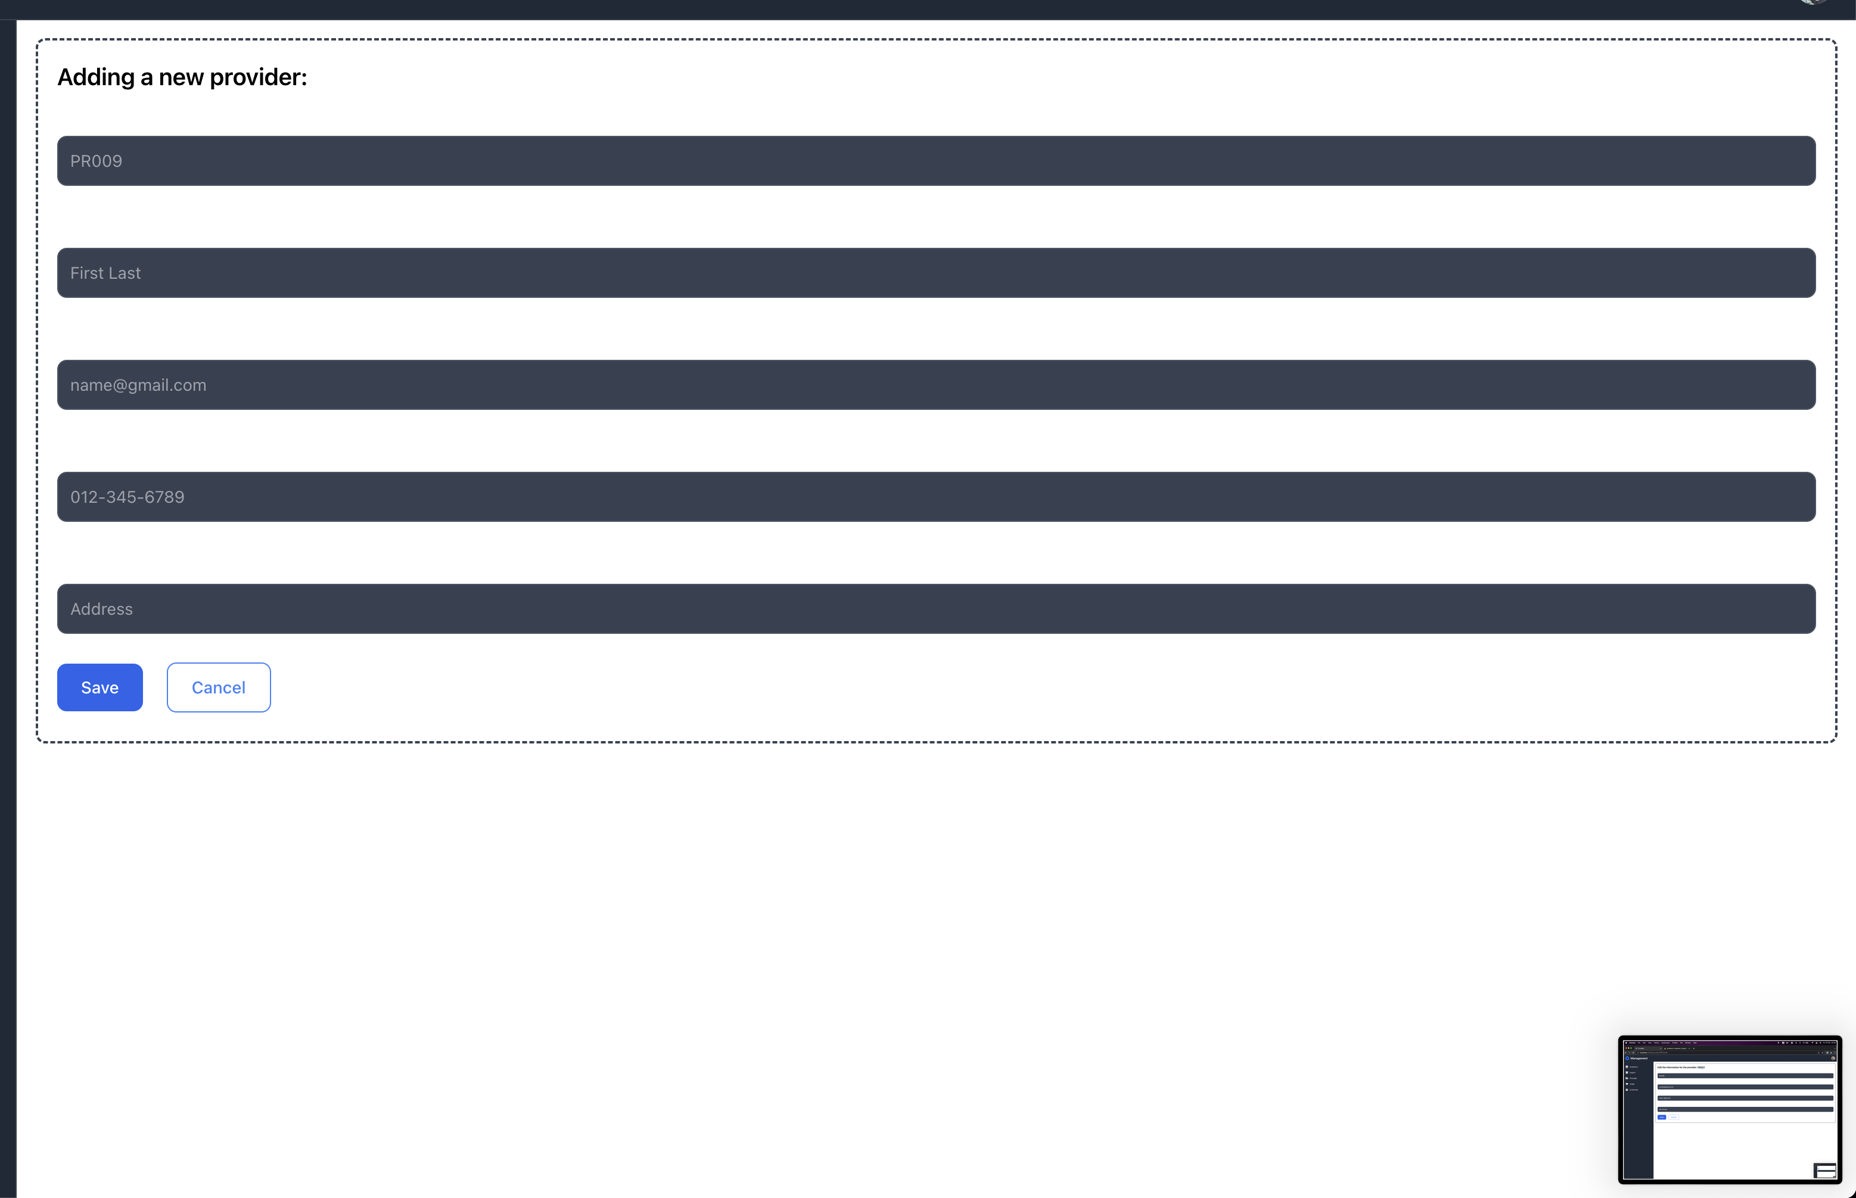
Insert new provider

